Slide 1

Conservation and Sustainable Development: A Journey Towards a Healthier Planet
Welcome to a journey into the fascinating world of conservation and sustainable development. This presentation will explore the principles and practices essential for safeguarding our planet's biodiversity and ensuring a sustainable future for generations to come.
DP
by Dr. Bharat Pandram

Slide 2

Defining Conservation and Sustainable Development
Conservation focuses on protecting and managing natural resources, while sustainable development aims to meet current needs without compromising the ability of future generations to meet their own. These concepts are intertwined and crucial for a healthy planet.
Conservation
Sustainable Development
Preserving natural resources like forests, oceans, and wildlife for future generations.
Meeting current needs without compromising the ability of future generations to meet their own.

Slide 3
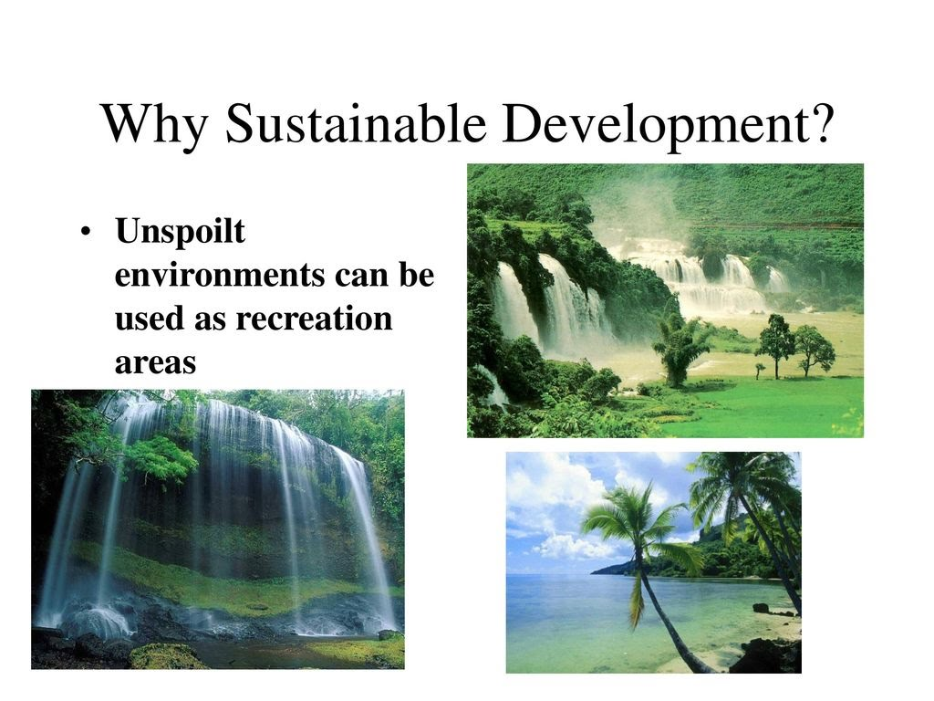
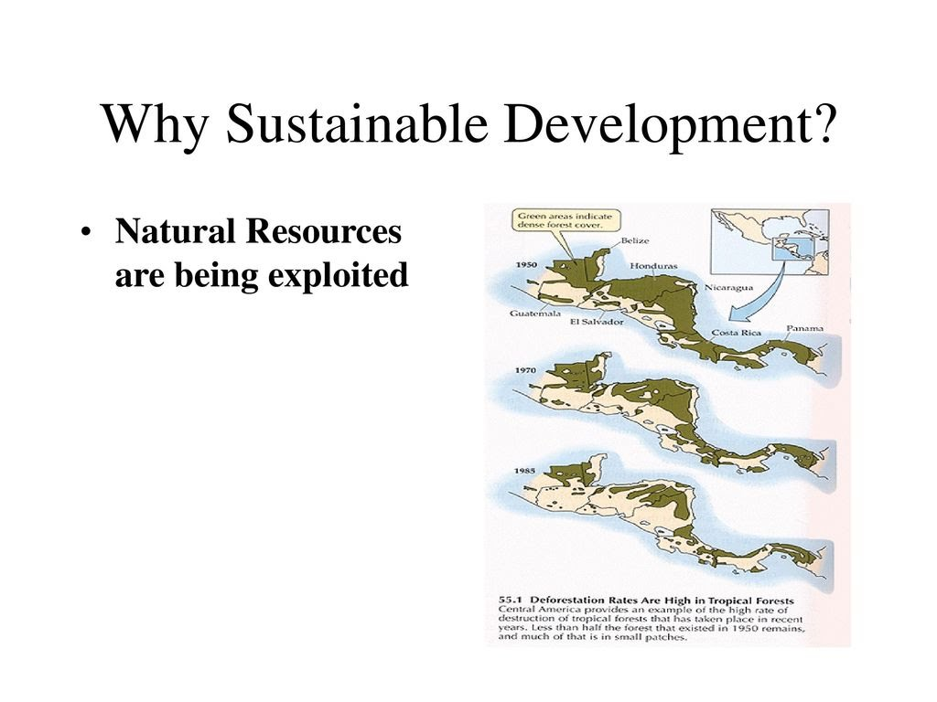
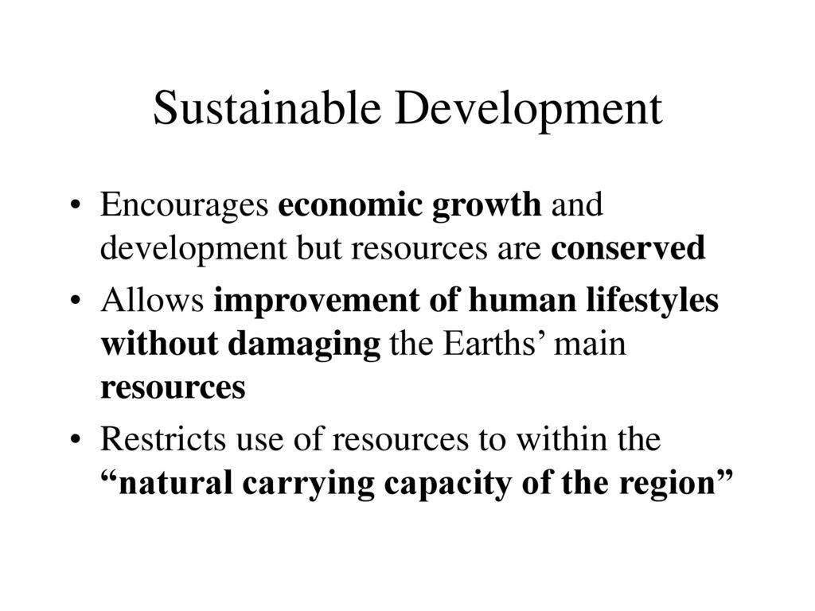
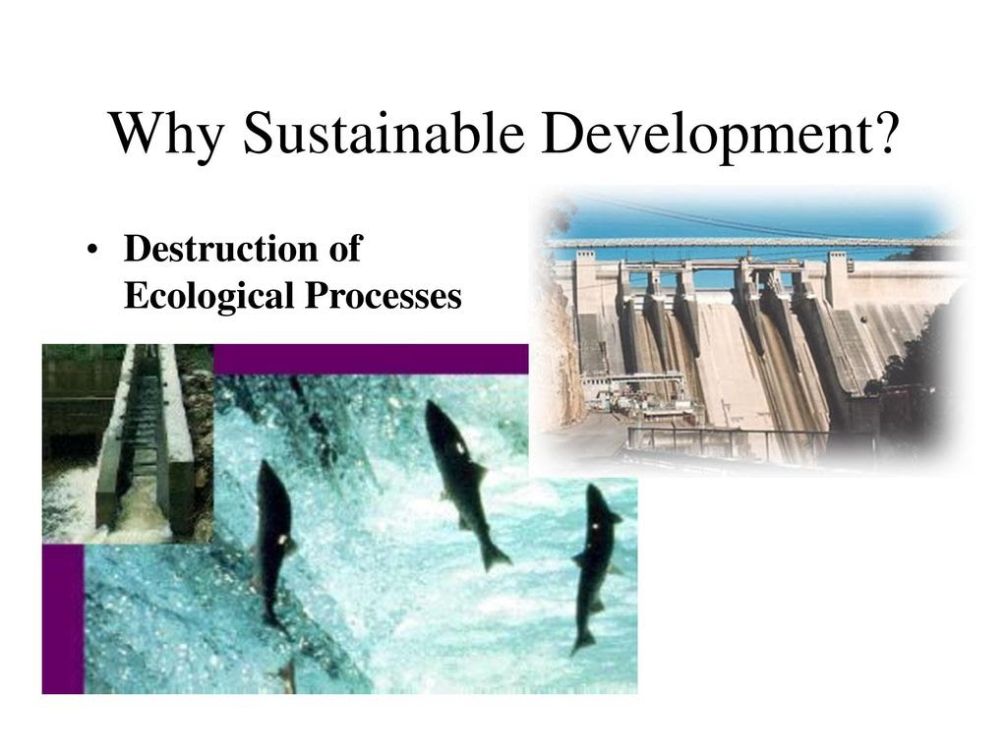
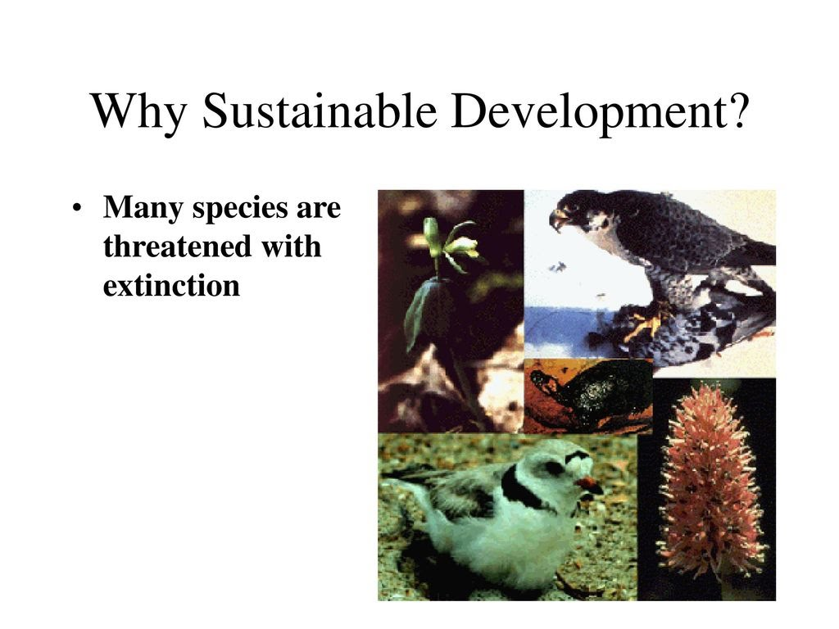

Slide 4
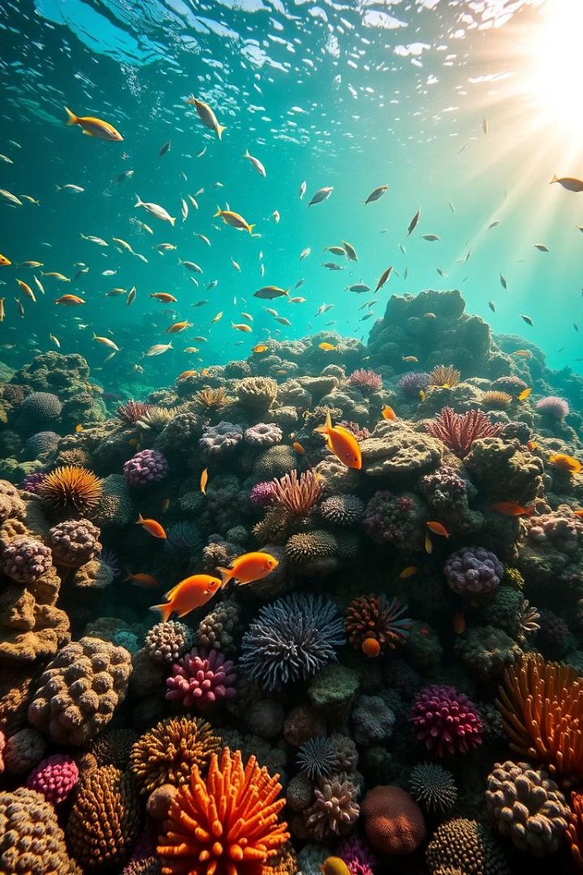
The Importance of Biodiversity
Biodiversity, the variety of life on Earth, is crucial for ecosystem stability and resilience. Diverse ecosystems provide essential services like pollination, water filtration, and climate regulation.
1
Ecosystem Services
2
Resilience
Biodiversity provides essential services like pollination, water filtration, and climate regulation.
Diverse ecosystems are more resilient to disturbances like climate change and invasive species.
3
Medicinal Resources
Many medicines are derived from natural sources, highlighting the importance of biodiversity for human health.

Slide 5
Threats to Biodiversity and Ecosystems
Threats to biodiversity include habitat loss, pollution, climate change, invasive species, and overexploitation. Addressing these threats is essential for preserving the natural world.
Habitat Loss
Pollution
Climate Change
Deforestation, urbanization, and agricultural expansion destroy natural habitats.
Pollution from industrial activities, agriculture, and waste contaminates air, water, and soil, harming wildlife.
Climate change alters weather patterns, causing habitat shifts, extreme weather events, and rising sea levels.

Slide 6
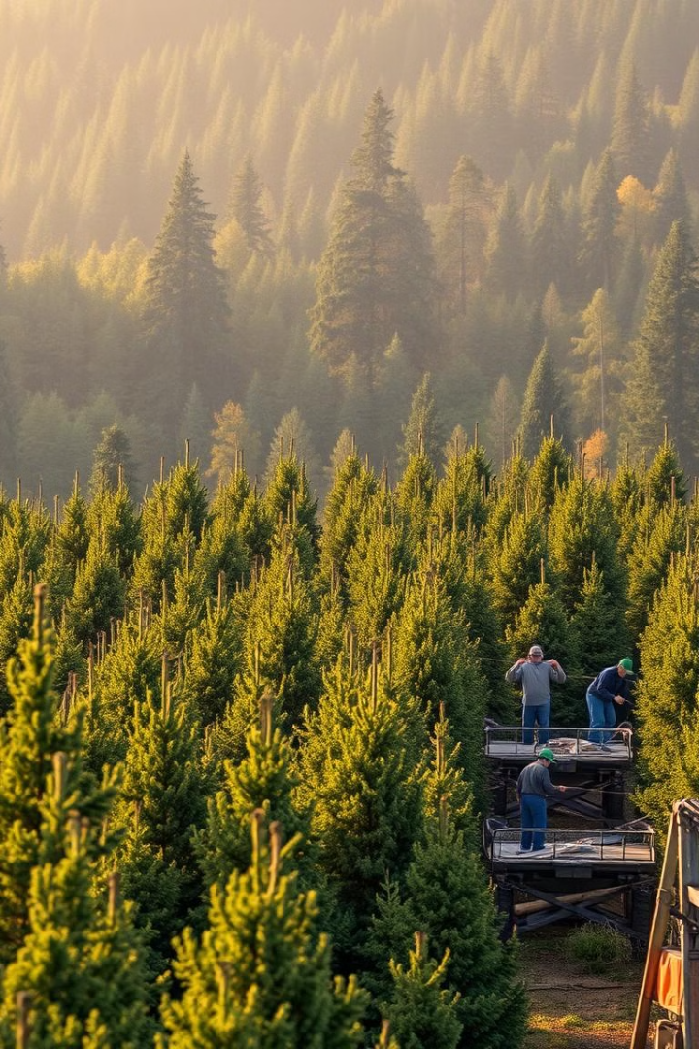
Sustainable Resource Management
Sustainable resource management involves using resources responsibly to meet current needs while ensuring their availability for future generations. It emphasizes conservation and responsible use.
1
Conservation
Protecting ecosystems and species from overexploitation and habitat loss.
2
Responsible Use
Using resources efficiently and minimizing waste to ensure their long-term availability.
3
Restoration
Restoring degraded ecosystems to their original condition or a more sustainable state.

Slide 7
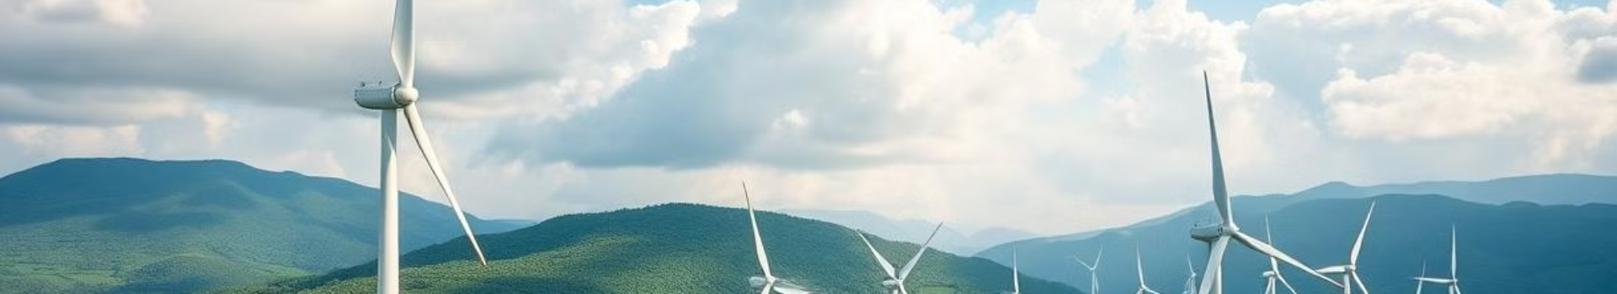



Renewable Energy and Sustainable Practices
Renewable energy sources like solar, wind, and hydro power offer clean and sustainable alternatives to fossil fuels. Shifting towards renewable energy is crucial for mitigating climate change.
Solar Energy
Wind Energy
Hydropower
Harnessing sunlight to generate electricity.
Using wind to power turbines and generate electricity.
Utilizing the flow of water to generate electricity.

Slide 8
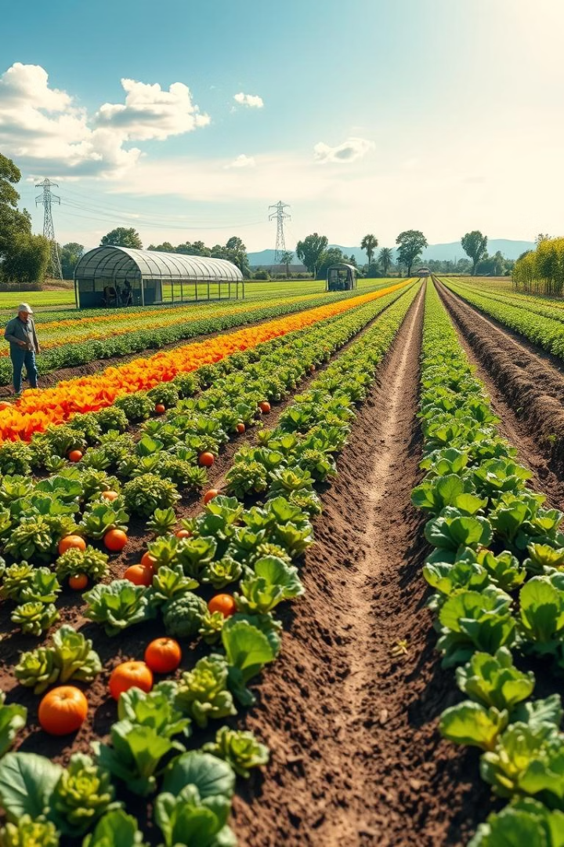
Sustainable Agriculture and Food Production
Sustainable agriculture practices focus on producing food while minimizing environmental impact. Organic farming, agroforestry, and crop rotation are examples of sustainable methods.
Organic Farming
Minimizes pesticide and fertilizer use.
Agroforestry
Integrates trees with crops and livestock for biodiversity and soil health.
Crop Rotation
Rotating different crops to improve soil fertility and pest control.

Slide 9
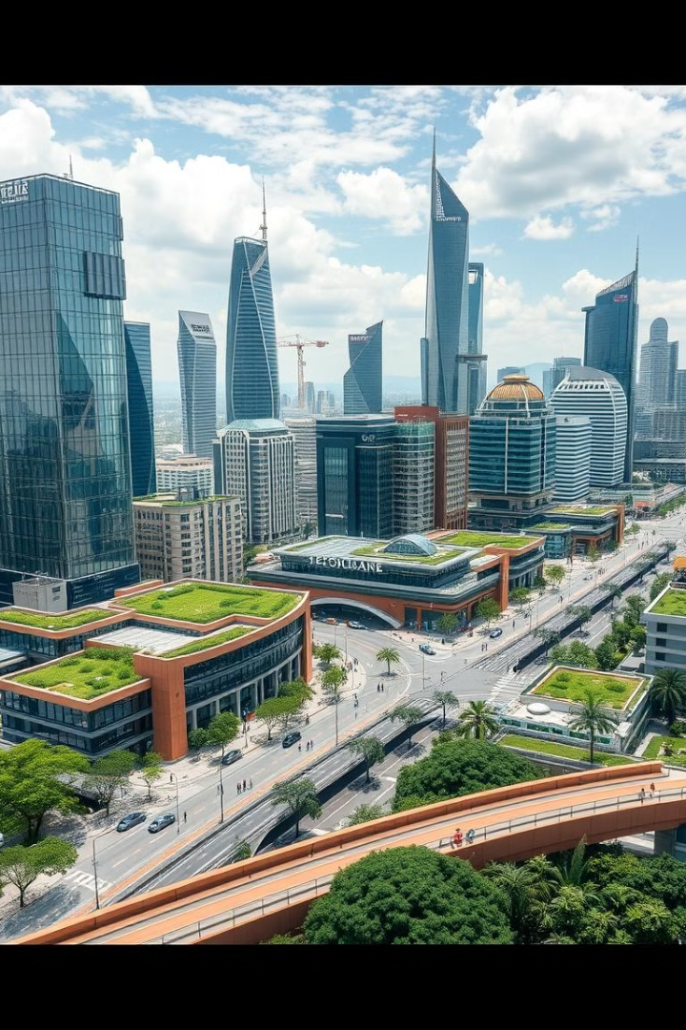



Sustainable Urban Planning and Design
Sustainable urban planning aims to create cities that are environmentally friendly, economically viable, and socially equitable. Green spaces, efficient transportation, and sustainable building practices are key elements.
Green Spaces
Parks and green spaces improve air quality, reduce heat islands, and enhance quality of life.
Efficient Transportation
Promoting public transportation, cycling, and walking reduces traffic congestion and emissions.
Sustainable Buildings
Energy-efficient buildings minimize resource consumption and reduce environmental impact.

Slide 10

Community Engagement and Empowerment
Community engagement is crucial for effective conservation and sustainable development. Empowering local communities to participate in decision-making and implement solutions is essential.
1
Education and Awareness
2
Participation
3
Empowerment
Educating communities about environmental issues fosters understanding and promotes action.
Involving communities in decision-making ensures projects align with local needs and values.
Providing communities with resources and training to implement sustainable solutions.

Slide 11
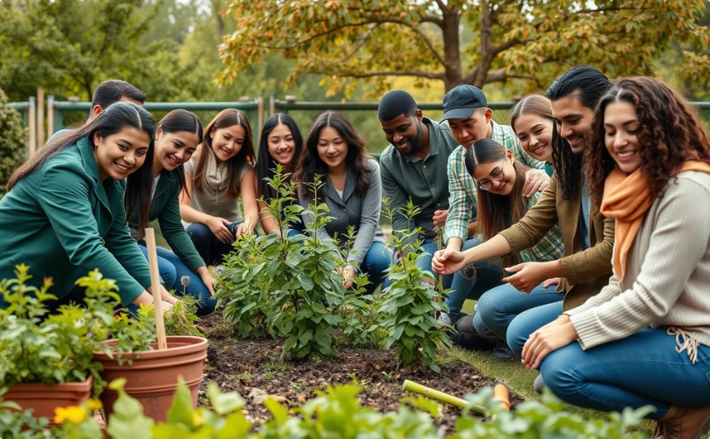
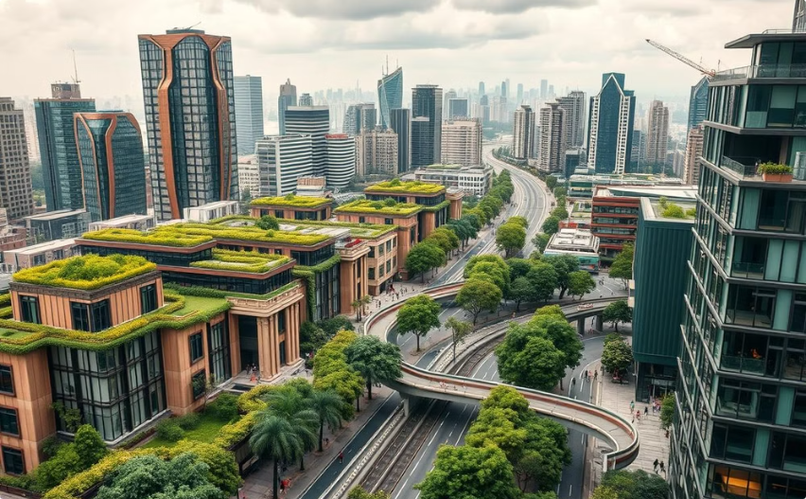
The Future of Conservation and Sustainable Development
The future of conservation and sustainable development relies on collaboration, innovation, and a commitment to safeguarding our planet. By working together, we can create a sustainable future for all.
Collaborative Action
Technological Innovation
Working together across sectors, communities, and governments to achieve shared goals.
Leveraging technology to develop sustainable solutions and monitor environmental progress.

